Slide 1

Introduction to Python (week 3)
Louis Rey
UCSD Extension

Slide 2
Week 3 Objectives
String methods
Dictionaries
Output Formatting
Looping and Repetition Statements
List comprehensions
Memory Structure
Functions and Methods
Programming Scope
Recursion

Slide 3
String Methods

Slide 4
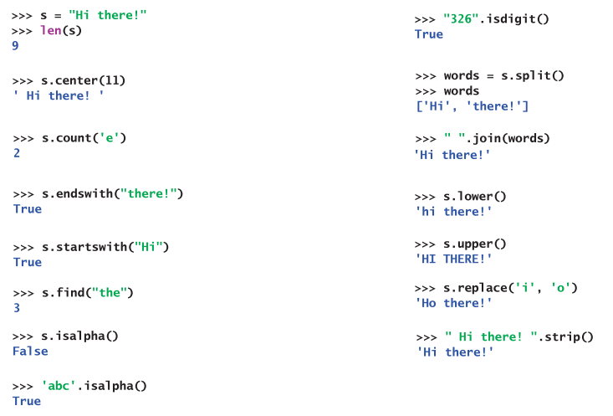
String Methods

Slide 5
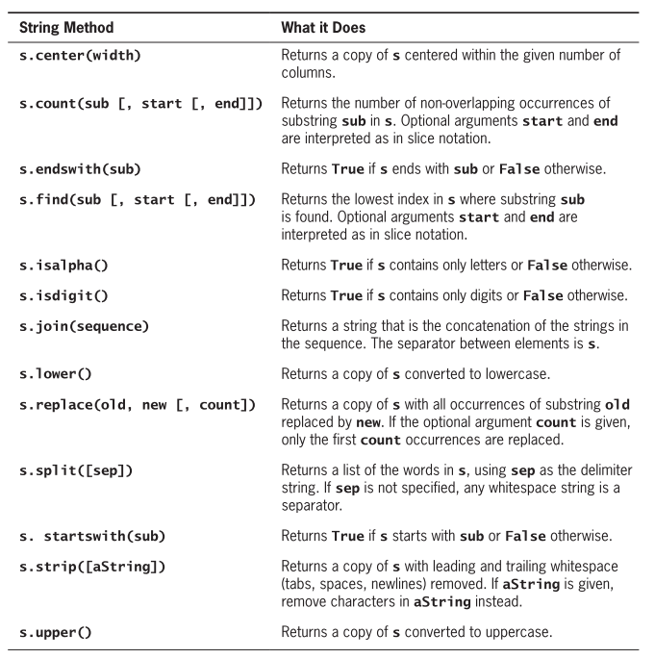
String Methods Summary

Slide 6
Dictionaries

Slide 7
Dictionaries: A Matching Type
• Dictionaries store a mapping between a set of keys and a set of values.
• Keys can be any immutable type.
• Values can be any type
• A single dictionary can store values of different types
• You can define, modify, view, lookup, and delete the key-value pairs in
the dictionary.

Slide 8
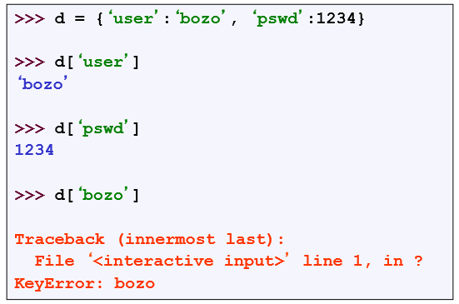
Creating and Accessing Dictionaries

Slide 9
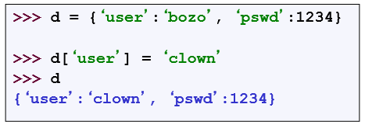
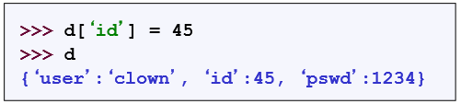
Updating Dictionaries
• Keys must be unique.
• Assigning to an existing key replaces its value.
• Dictionaries are unordered
• New entry might appear anywhere in the output.
• (Dictionaries work by hashing – Associative arrays)

Slide 10
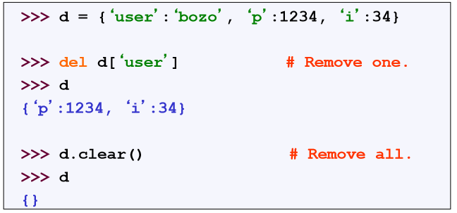
Removing Dictionaries Entries

Slide 11
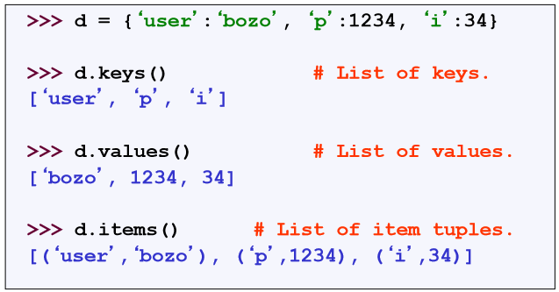
Useful Access Methods

Slide 12
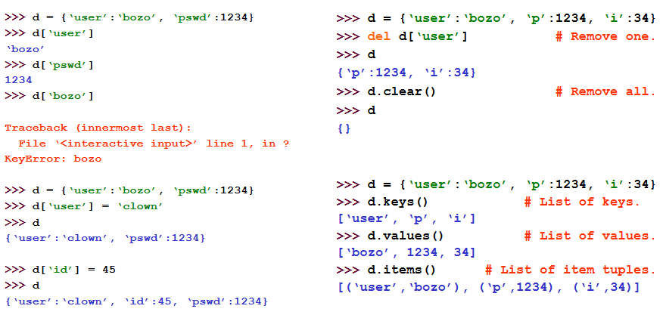
Using Dictionaries

Slide 13
Basic Formatting

Slide 14
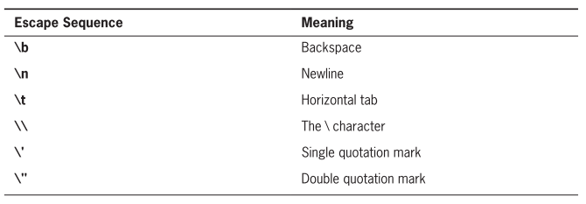
Escape Sequences

Slide 15
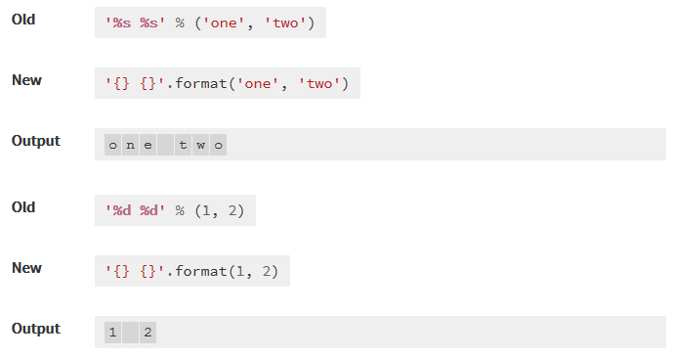
Basic Formatting

Slide 16
Basic Formatting
%s - String (or any object with a string representation, like numbers)
%d – Integers
%f – Floating point numbers
%.<number of digits>f – Floating point numbers with a fixed amount of digits to the right of the dot (e.g. %.2f for monetary presentation)
%x / %X – Integers in hex representation (lowercase/uppercase)

Slide 17
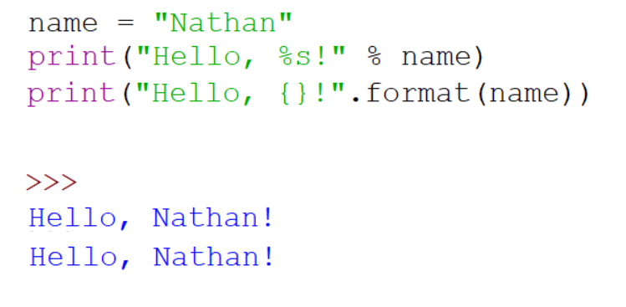
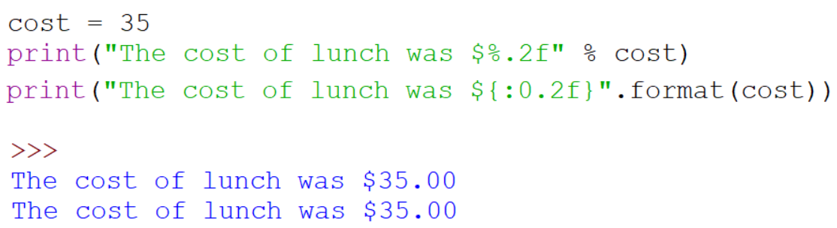
Basic Formatting

Slide 18
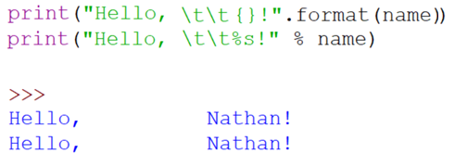
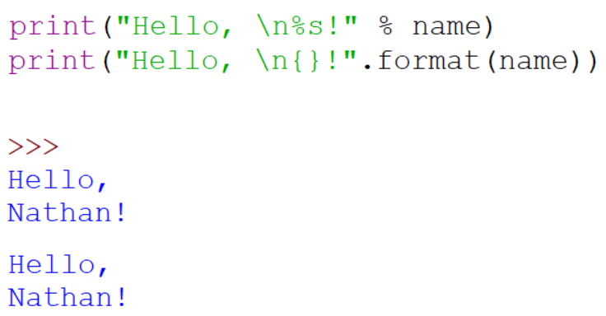
Basic Formatting

Slide 19
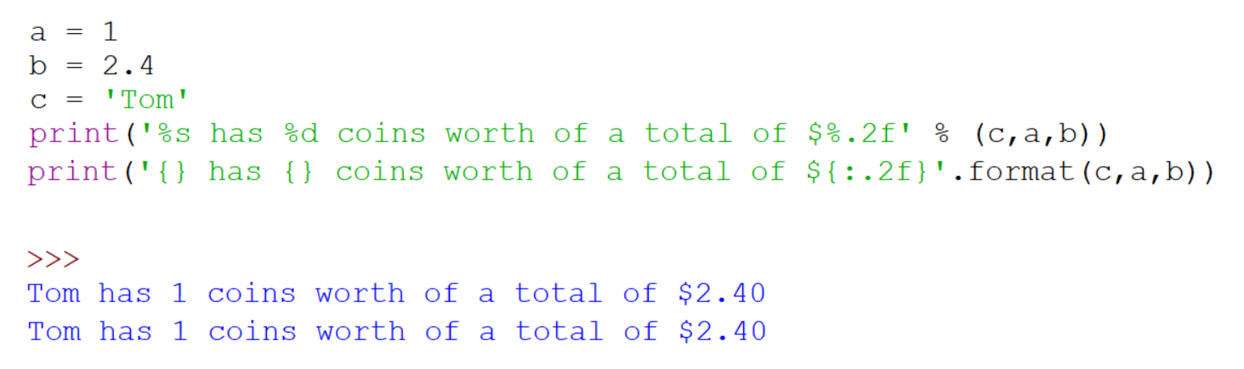
Basic Formatting

Slide 20
Control of Flow

Slide 21
Control of Flow
• There are several Python expressions that control the flow of a
program. All of them make use of Boolean conditional tests.
• if Statements
• while Loops
• assert Statements

Slide 22
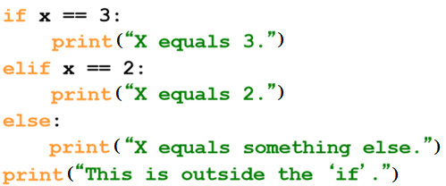
If Statements
Be careful! The keyword if is also used in the syntax of filtered list comprehensions.
Note:
• Use of indentation for statement blocks
• Colon (:) after Boolean expression

Slide 23
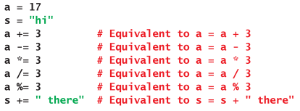
Augmented Assignments

Slide 24
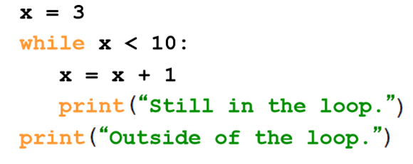
While Loops

Slide 25
For Loops

Slide 26
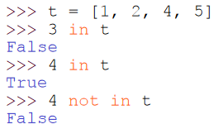
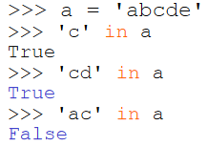
The ‘in’ Operator
• Boolean test whether a value is inside a container:
• For strings, tests for substrings
• Be careful: the in keyword is also used in the syntax of for loops and
list comprehensions.

Slide 27
For Loops/ List Comprehensions
• Python’s list comprehensions and split/join operations provide natural idioms that usually require a for-loop in other programming languages.
• As a result, Python code uses many fewer for-loops
• Nevertheless, it’s important to learn about for-loops.
• Caveat! The keywords for and in are also used in the syntax of list comprehensions, but this is a totally different construction.

Slide 28
For Loops
• A for-loop steps through each of the items in a list, tuple, string, or any other type of object which is “iterable”
for <item> in <collection>:
<statements>
• If <collection> is a list or a tuple, then the loop steps through each element of the sequence.
• If <collection> is a string, then the loop steps through each character of the string.
for someChar in “Hello World”:
print someChar

Slide 29
For Loops
for <item> in <collection>:
<statements>
• <item> can be more complex than a single variable name.
• When the elements of <collection> are themselves sequences, then <item> can match the structure of the elements.
• This multiple assignment can make it easier to access the individual
parts of each element.

Slide 30
For Loops and the Range() Function
• Since a variable often ranges over some sequence of numbers, the range() function returns a list of numbers from 0 up to but not including the number we pass to it.
• range(5) returns [0,1,2,3,4]
• So we could say:
for x in range(5):
print (x)
• (There are more complex forms of range() that provide richer functionality…)

Slide 31
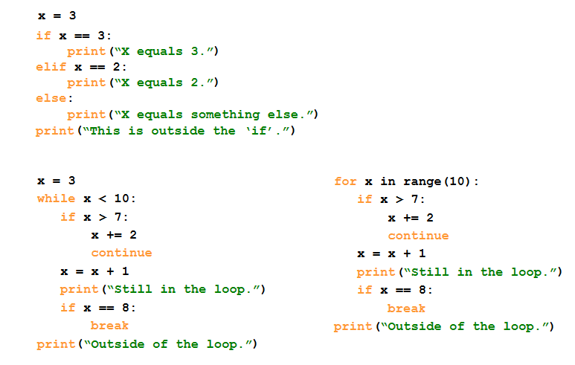
Examples

Slide 32
Generating Lists using “List Comprehensions”

Slide 33
List Comprehensions
• A powerful feature of the Python language.
• Generate a new list by applying a function to every member of an original list.
• Python programmers use list comprehensions extensively.
You’ll see many of them in real code.
• The syntax of a list comprehension is somewhat tricky.
• Syntax suggests that of a for-loop, an in operation, or an if statement
- all three of these keywords (‘for’, ‘in’, and ‘if’) are also used in the syntax of forms of list comprehensions.

Slide 34
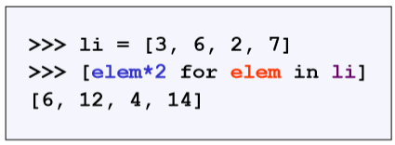
List Comprehensions
[ expression for name in list ]
• Where expression is some calculation or operation acting upon the variable name.
• For each member of the list, the list comprehension
1. sets name equal to that member,
2. calculates a new value using expression,
• It then collects these new values into a list which is the return value of the list comprehension.

Slide 35
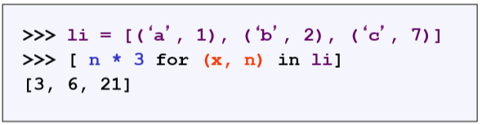
List Comprehensions
[ expression for name in list ]
• If list contains elements of different types, then expression must
operate correctly on the types of all of list members.
• If the elements of list are other containers, then the name can consist
of a container of names that match the type and “shape” of the list
members.

Slide 36
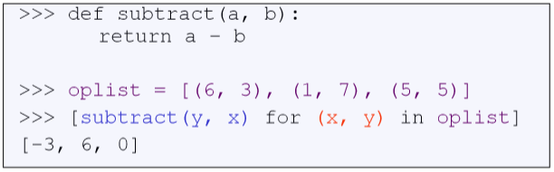
List Comprehensions
[ expression for name in list ]
• expression can also contain user-defined functions.

Slide 37
Filtered List Comprehensions
[expression for name in list if filter]
• Filter determines whether expression is performed on each member of the list.
• For each element of list, checks if it satisfies the filter condition.
• If it returns False for the filter condition, it is omitted from the list before the list comprehension is evaluated.

Slide 38
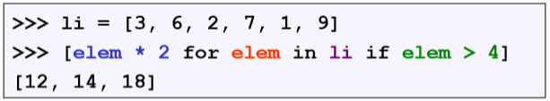
Filtered List Comprehensions
[expression for name in list if filter]
• Only 6, 7, and 9 satisfy the filter condition.
• So, only 12, 14, and 18 are produced.

Slide 39
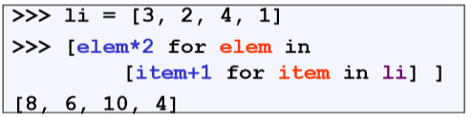
Nested List Comprehensions
• Since list comprehensions take a list as input and produce a list as
output, they are easily nested:
• The inner comprehension produces: [4, 3, 5, 2].
• So, the outer one produces: [8, 6, 10, 4].

Slide 40
Memory Structure

Slide 41
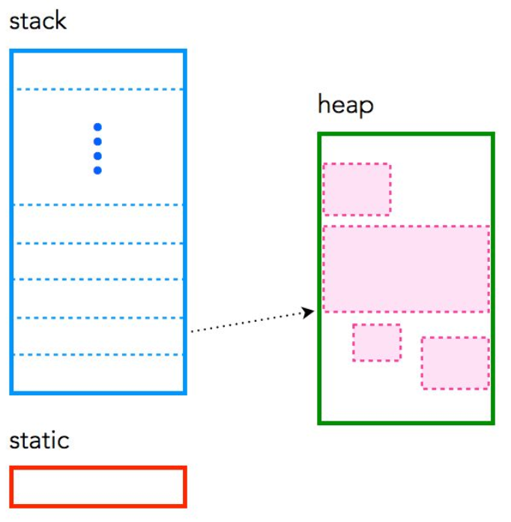
Memory Structure
static: global variable storage, permanent for the entire run of the program
stack: local variable storage (automatic, continuous memory)
heap: dynamic storage (large pool of memory, not allocated in contiguous order).

Slide 42
Functions

Slide 43
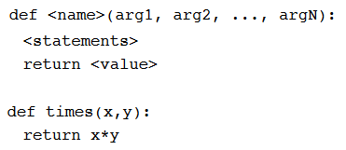
Functions
• def creates a function and assigns it a name
• return sends a result back to the caller
• Arguments are passed by assignment
• Arguments and return types are not declared

Slide 44
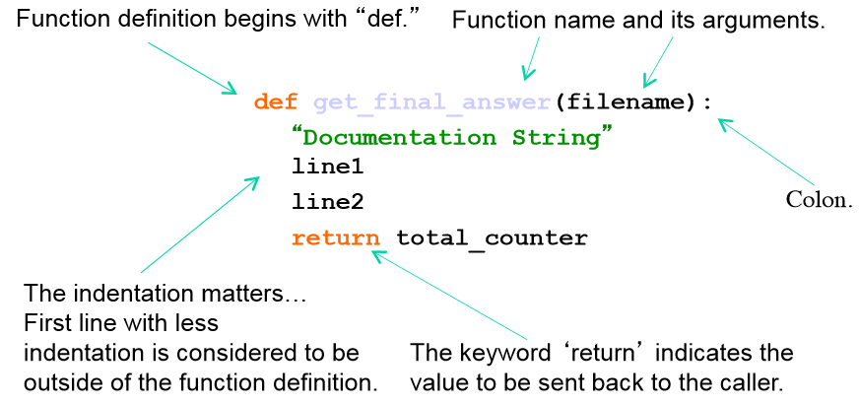
Defining Functions

Slide 45
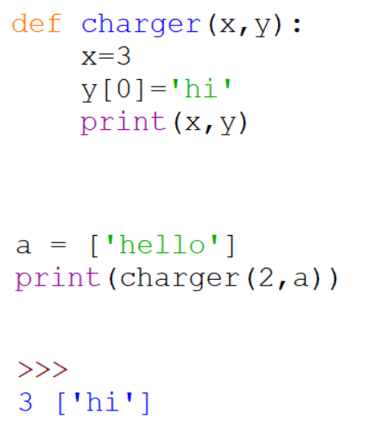
Passing Arguments to Functions
• Arguments are passed by assignment
• Passed arguments are assigned to local names
• Assignment to argument names don't affect the caller
• Changing a mutable argument may affect the caller

Slide 46
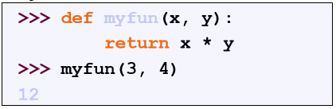
Calling a Functions
• The syntax for a function call is:
• Parameters in Python are “Call by Assignment.”
• Sometimes acts like “call by reference” and sometimes like
“call by value” in C++.
- Mutable datatypes: Call by reference.
- Immutable datatypes: Call by value.

Slide 47
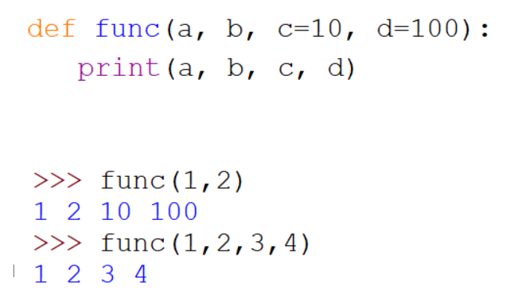
Optional Arguments
• Can define defaults for arguments that need not be passed

Slide 48
Gotchas
• All functions in Python have a return value
• even if no return line inside the code.
• Functions without a return returns the special value None.
• There is no function overloading in Python.
• Two different functions can’t have the same name,
even if they have different arguments.
• Functions can be used as any other data type.
They can be:
• Arguments to function
• Return values of functions
• Assigned to variables
• Parts of tuples, lists, etc

Slide 49
Program Scope

Slide 50
Local and Global Scope
• Local Scope
• Visible only to a function or method that contains it
• Visible only to a Class and it’s instances
• Global Scope
• Visible to all areas of a code
• Variables declared outside of a function or class
• global keyword needed to make data or variables visible within a function or class
• nonlocal keyword used when nesting one function inside another function

Slide 51
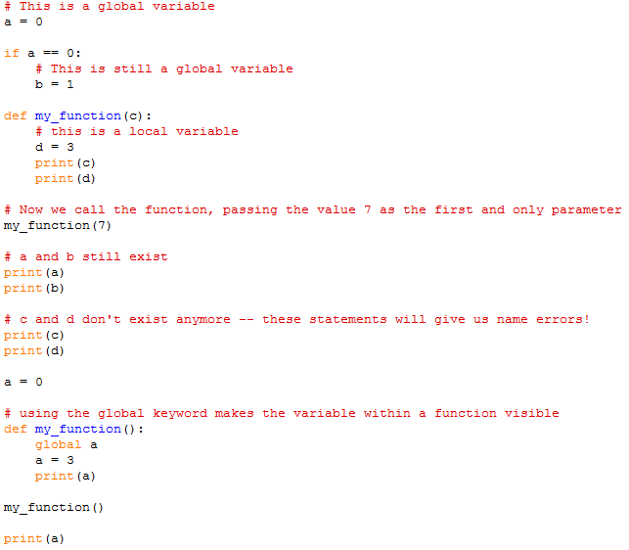
Local and Global Scope

Slide 52
Recursive Functions

Slide 53
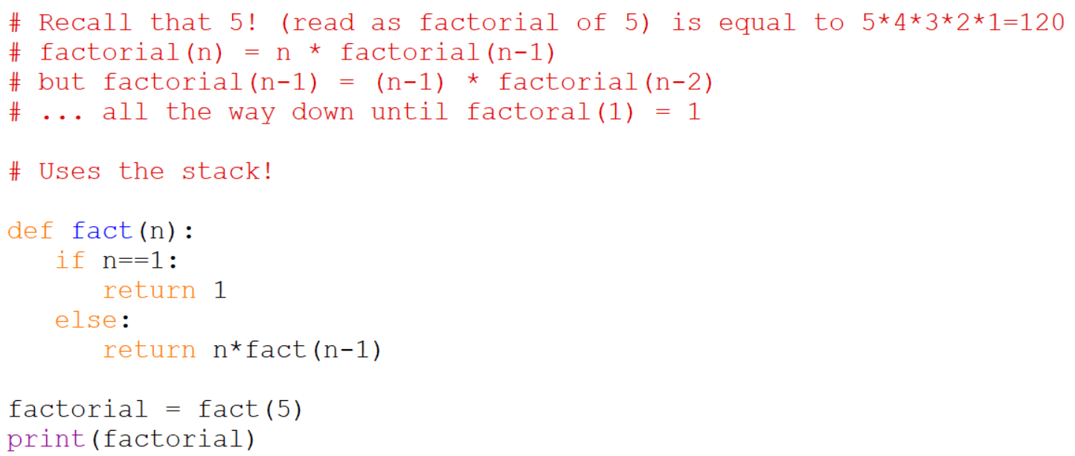
Recursive Functions
This only works for positive numbers, not negative one
Cannot complete the answer until the number reaches 1
Multiple variable called n are created, not just one n
Needs to work out what fact(5) is, but needs fact(4) … until fact(1) is reached

Slide 54
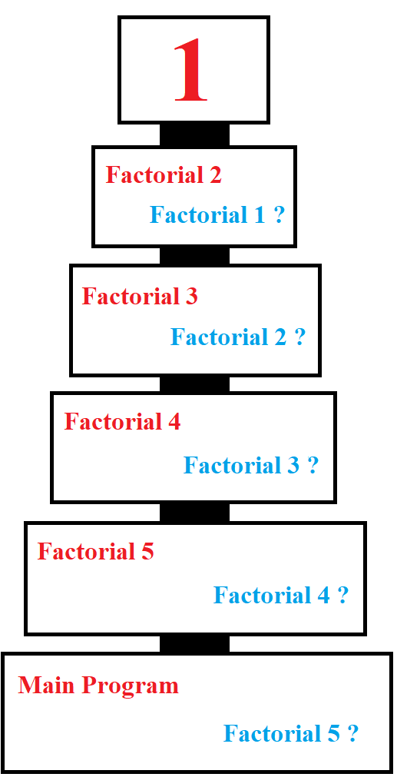
Recursive Functions
Composed of a series of pending multiplies
➔ Factorial 1 = 1
➔ 2 * Factorial 1 = 2 * 1 = 2
➔ 3 * Factorial 2 = 3 * 2 = 6
➔ 4 * Factorial 3 = 4 * 6 = 24
➔ 5 * Factorial 4 = 5 * 24 = 120
➔ Factorial 5 = 120

Slide 55
Resources
Matt Huenerfauth (Penn State)
Guido van Rossum (Google)
Richard P. Muller (Caltech)
Bill Boyd (Weslayan University)
Smithsonian Telescope Data Center
Programming Python, Mark Lutz
Fundamentals of Python, Kenneth Lambert

